Slide 1
Research Assistant in Computational Engineering
Jönköping University
LEARNINGS
Adithya Sivakumar

Slide 2
Meeting SUMMARY – 24/02/26
Perform Digital Image Correlation fully in python
Basic script in MATLAB is available
Strain measurement based on position of markers on the beam
Real-time strain monitoring in UTM is the goal
Final outcome: comparative result from real time DIC rig and tensile machine
Alternate possibility: Extract stress-strain data and create material model for FDM materials
Mechatronics course: workshop help with integration of remote-controlled car (wiring, CAD, 3-D printing, programming, etc.)
Course focus is on systematic approach to problem-solving

Slide 3
PRE-Study agenda
Digital Image Correlation
  Know about Good Practices Guide for DIC
Python for DIC
  Check out libraries ( OpenCV)
  Refresh python skills
Know about the camera and specs
  Basler ACA2440 35 micrometer, 25mm lens (specifications)

Slide 4
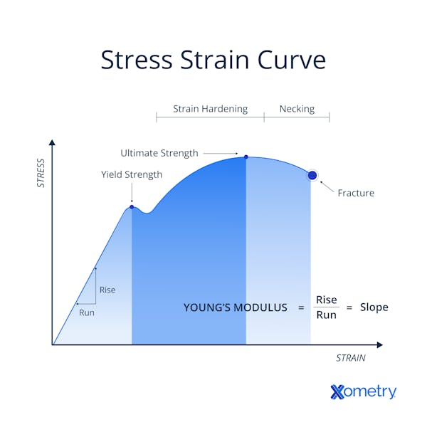
Literature

Slide 5
Visual studio Code – Things to know
Tutorial - Getting started with Visual Studio Code

Slide 6
OpenCV-Python
OpenCV-Python library is used for solving:
  Real-time computer vision, image processing, and machine learning tasks

Slide 7
Design of DIC Measurements
SUMMARY DERIVED FROM: Good Practices Guide for DIC → DIC Study GUIDE
Section 1 – Document Summary The 166-page iDICs guide covers everything from principles to reporting. It is a good-practices reference (not a rigid standard), but crucial guidelines must be followed for trustworthy results.
Section 2 – What is DIC? DIC tracks a random speckle pattern between images to compute full-field displacements and strains. Key terminology (QOI, ROI, FOV, SOD, subset, VSG, etc.) is defined in a reference table. The key 1D vs 2D-DIC comparison table shows when to use each.
Section 3 – Test Rig Setup Covers camera selection (global shutter, monochromatic, disable all auto functions), lens selection (fixed focal length preferred, lockable rings), mounting requirements (rigid, decoupled from load frame), and lighting setup (diffuse LEDs, symmetric, locked before the test).
Section 4 – Key Factors and How Each Affects Results This is the core technical section:
        Speckle pattern: 3–5 px feature size is the critical rule. Random, matte, ~50% coverage, well-bonded.
        Aperture: controls DOF — set once and lock.
        Exposure time: motion blur must be < 0.5 px; aim for 50–80% gray level.
        Frame rate: governed by test speed and Nyquist theorem.
        Subset size: typically, 31–41 px starting point; must contain 3–5 speckles.
        Step size: typically, 1/3 to 1/5 of subset size.
        VSG (Virtual Strain Gauge): the physical gauge length for strain — always do a VSG study.
        Noise-floor: evaluate and report before and after the test.

Slide 8
Design of DIC Measurements
Chapter 2: Good Practices Guide for DIC
Section 5 – Calibration Pre-calibration checklist (warm-up, focus, aperture lock), 2D-DIC calibration, and full stereo-DIC calibration with recommended target orientations.
Section 6 – Performing the Test Pre-test checklist, reference image strategy, in-test discipline.
Section 7 – DIC Analysis Software parameters (matching criterion, interpolant, strain tensor), VSG study procedure step-by-step.
Section 8 – Starting with 1D DIC Your entry point: a flat tensile specimen, single camera, virtual extensometer — then progressively moving to full 2D-DIC.
Section 9 – Reporting Requirements Every parameter you must document, in line with the iDICs guide's minimum reporting requirements.
Section 10 – Quick Reference Numbers A complete table of all key numbers in one place, plus the false strain vs. SOD table for 2D-DIC.

Slide 9
Basler ACA2440 Specs
DIC‑relevant specs for the Basler ACA2440‑35um :
Aspect | Specification / Feature | Why it matters for DIC
Sensor type | Sony IMX264, CMOS, global shutter | Global shutter avoids motion distortion during loading.
Resolution | 2464 × 2056 (~5 MP) | Controls spatial resolution and detail in displacement/strain fields.
Pixel size | 3.45 × 3.45 µm | Sets physical size per pixel with a given lens, affects strain resolution.
Sensor format | 2/3", 11.1 mm diagonal | Needed to select lenses and determine field of view.
Frame rate | 35 fps (at full resolution) | Limits how fast you can capture dynamic events.

Slide 10
Basler ACA2440 Specs
DIC‑relevant specs for the Basler ACA2440‑35um :
Aspect | Specification / Feature | Why it matters for DIC
Shutter/exposure control | Programmable exposure, global shutter | Trade off motion blur vs. noise and sync with lighting.
Triggering | Hardware and software trigger, free‑run | Hardware trigger enables frame‑accurate multi‑camera synchronization.
Color/mono | Monochrome | Better contrast and SNR; avoids Bayer interpolation, ideal for speckle patterns.
Data interface | USB 3.0 (up to 5 Gbit/s) | Supports streaming full‑res images at required frame rate with low drop risk.
Lens mount | C‑mount | Wide lens availability to set FOV and speckle size on sensor.

Slide 11
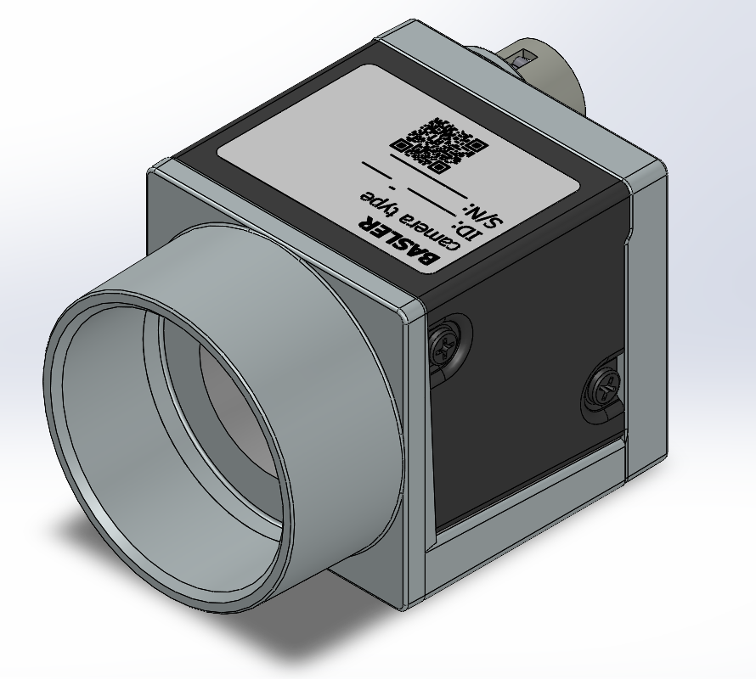
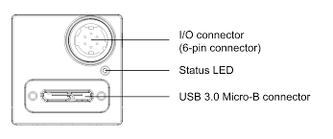
Basler ACA2440 35 micrometer, 25mm lens
Key Features of USB 3.0 Cables
Power Capability: USB 3.0 ports provide up to 900 mA (4.5 W) of power, almost double the 500 mA (2.5 W) provided by USB 2.0. This makes it ideal for powering peripheral devices like external hard drives or charging phones faster.
Data Transmission: USB 3.0 is known as "SuperSpeed" and supports data transfer rates up to 5 Gbps, which is 10 times faster than USB 2.0.
(specifications)

Slide 12
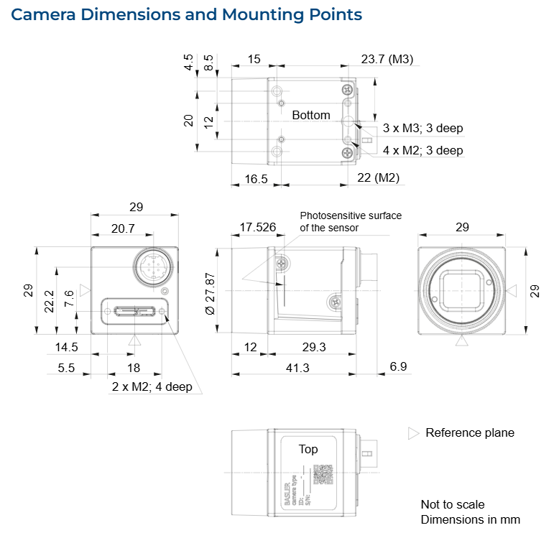
Basler ACA2440 35 micrometer, 25mm lens
(specifications)

Slide 13
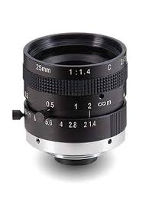
Azure-2514MML 25mm f/1.4 lens
The Two Rings
Ring 1 — Focus ring (usually the front ring)
Controls sharpness
Rotate until the image is sharp in Pylon Viewer
For your working distance (roughly 0.5-2m from specimen) you'll need to adjust this by eye.
Ring 2 — Aperture ring (usually the rear ring closer to camera body)
Controls how much light enters — this is your f-stop (f/1.4 to f/16)
f/1.4 = fully open = maximum light = bright image but shallow focus
f/8 or f/11 = more closed = less light but much sharper across the whole specimen
Specification sheet - AZURE-2514MML.pdf
IMAGE SOURCE

Slide 14
Basler ACA2440 35 micrometer, 25mm lens
(specifications)

Slide 15
UTM – Random points
Balancing the resolution and frame rate of the camera is important
Machine learning model can be added to create database

Slide 16
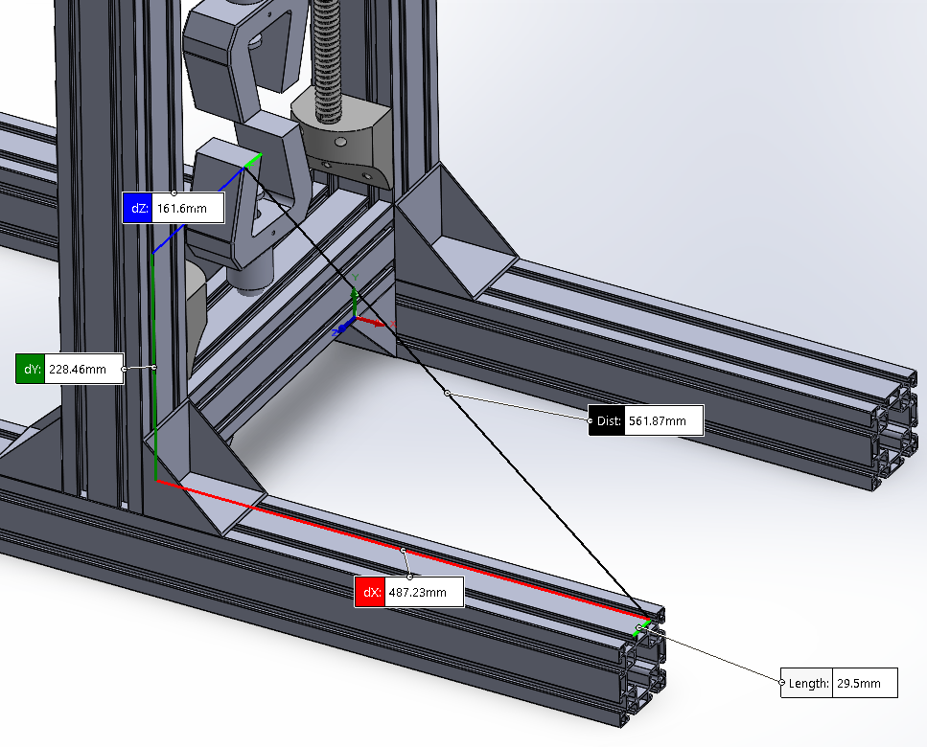
CAD: UTM assembly
Existing model
For checking X, Y and Z dimensions:
Go to Tools → Evaluate → Measure
Enable Projecting Curves
This is the setting that unlocks this:
Press Escape to exit Convert Entities
Go to Tools → Options
Click "External References" tab
Check "Allow multiple contexts for parts when editing in assembly" ✅
Click OK
Try Convert Entities again

Slide 17
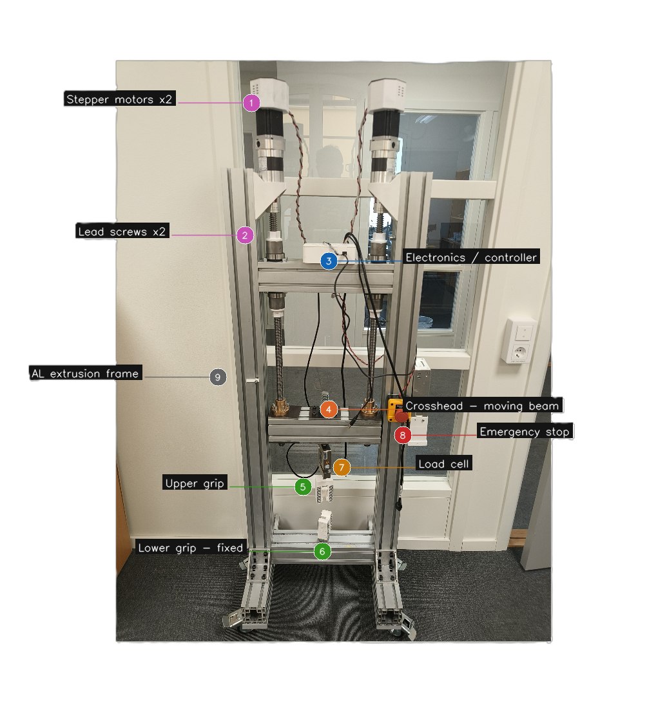
UTM – Test setup
1 - Stepper motor: they rotate the lead scews to move the crossheads up or down
2 – Lead Screws: Converts rotational motion of motor into linear vertical motion
3 – Electronics: Houses the motor drivers and microcontroller
4 - Crosshead (moving beam) - Horizontal beam that moves up during a tensile test.
5 - Upper grip: Clamps the top end of the specimen.
6 – Lower grip: Clamps the bottom end of the specimen and does not move.
7 - Load cell: Measures the force applied to the specimen in real time.
8 – Emergency stop: cuts power to the motors if something goes wrong.
9 - Aluminium extrusion frame: standard T-slot aluminium profiles bolted together.

Slide 18
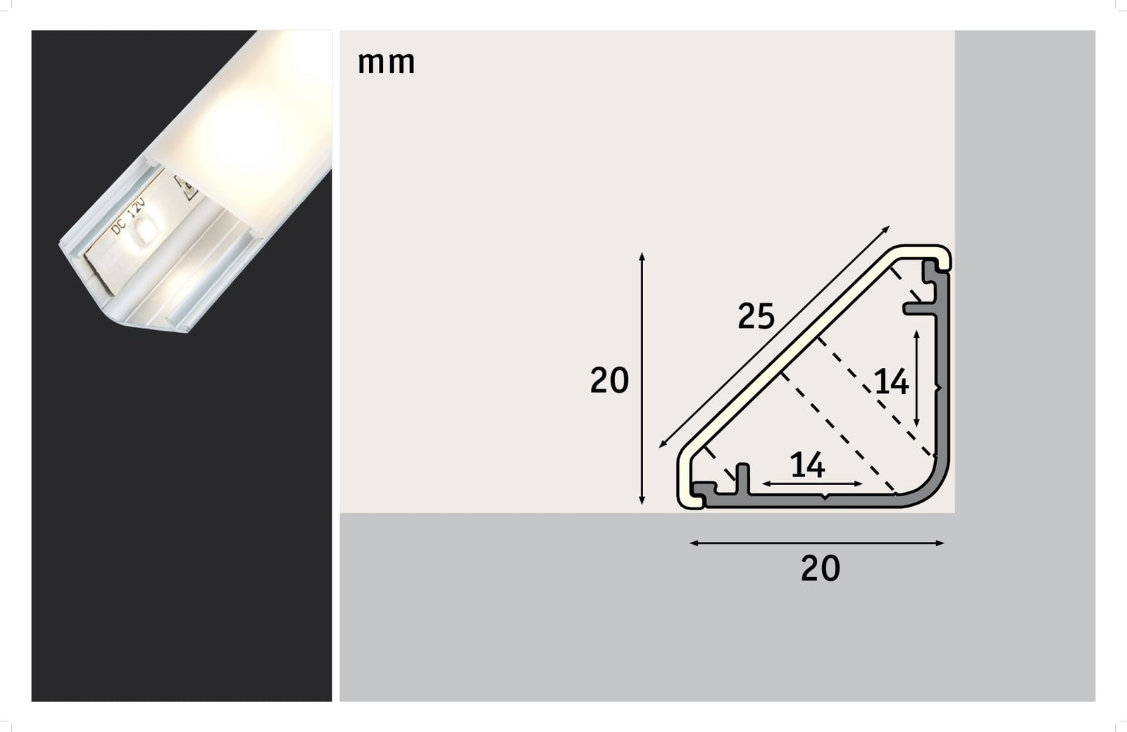
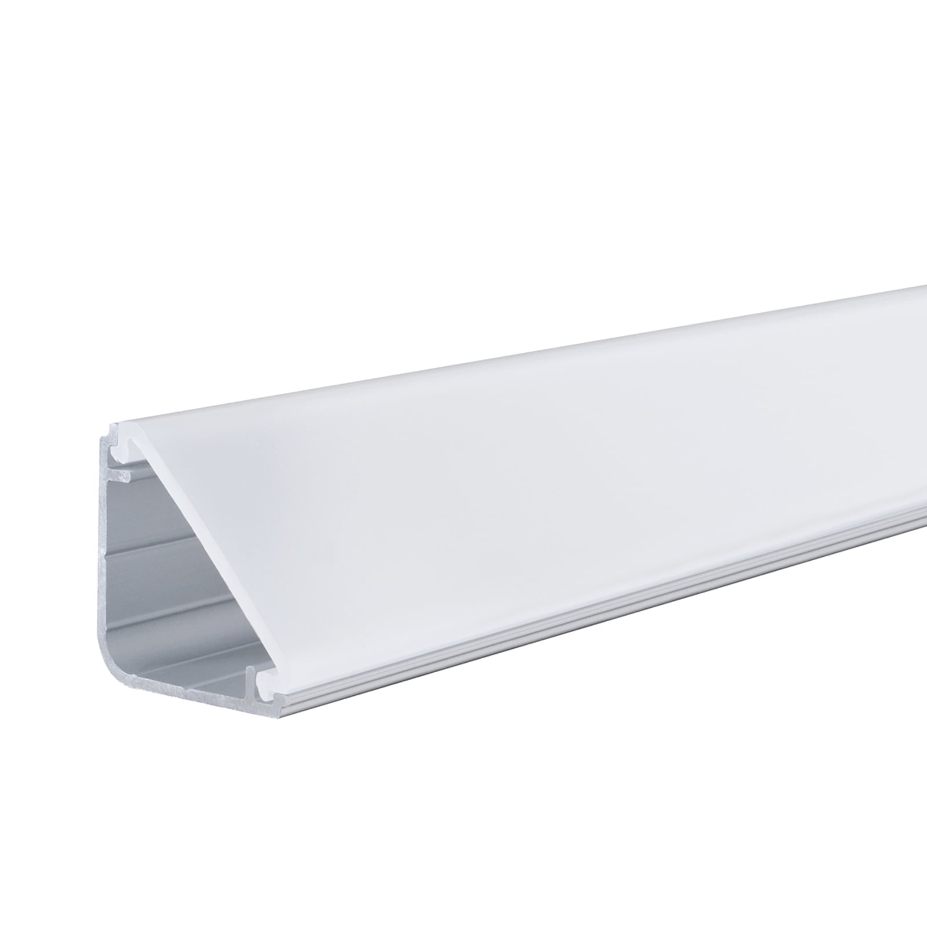
LED LIGHT DIFFUSOR - INSPIRATION
Delta-profil för Your LED-stripsystem, 1 m | Lamp24.se

